Slide 1
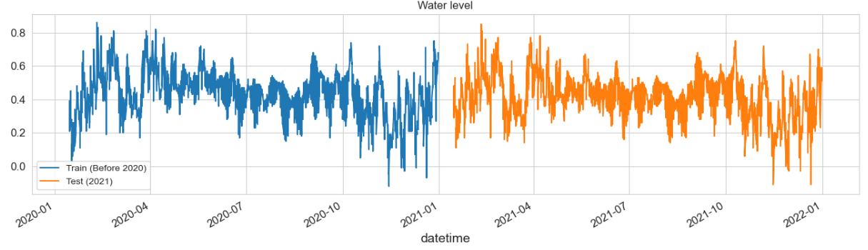
Overall endgoal Identification:
Predict water level at each point from 2020 – 2080.
Current Model:
Basic LSTM
Inputs:
- XY
datetime
Bed Level
Water level at each boundary point
Distance from each boundary point
Discharge from various sources

Slide 2
Findings:
LSTMs require continuous datetimes.
Why?
When the data gets plugged into the LSTM, the LSTM uses the sequential nature as its frame of reference. It has no “real” understanding of time, just understands ordering.

Slide 3
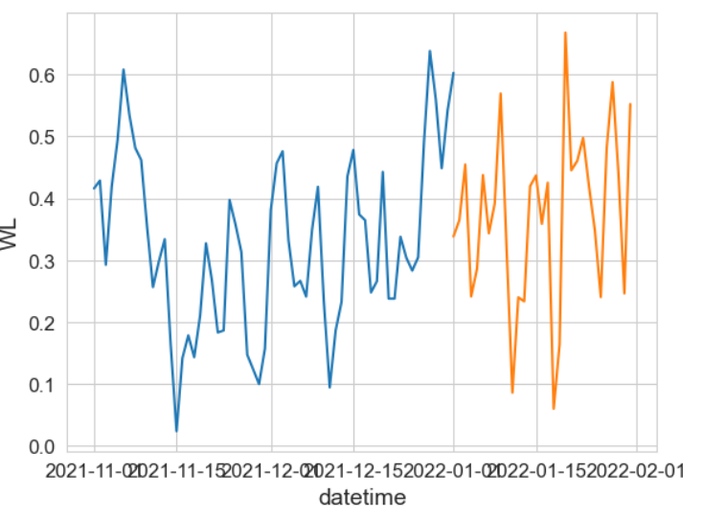
Future Predictions
Using Ahmed’s data, we have a framework for Emma’s work.
Using the previous 7 timesteps (days), we can predict n numbers of days in the future.
The predictions use the previous 7 timestamps– Predicted timestamps and seed timestamps.

Slide 4
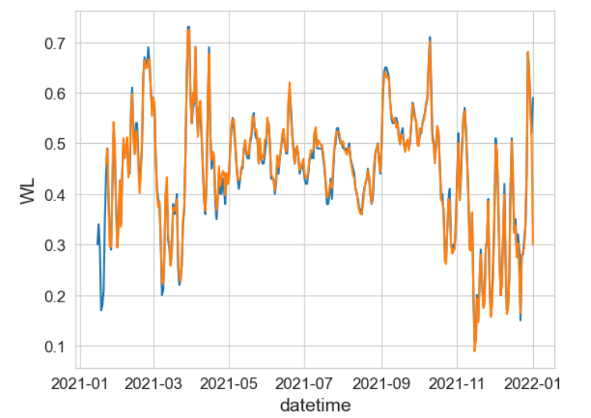
Current State of the Model &
Next Steps
Currently using a very barebones LSTM.
Looking to expand to a 2-layer LSTM or Bi-Directional LSTM.
Current RMSE:
0.0252 or 2.5% Error
Things from me:
Would like to train LSTM on full dataset. Ahmed generate a new dataset using different start parameters to test on.

Slide 5
Meeting with CS Professor
New Datashape
Current Datashape:
(n_samples x timesteps x n_features) Current data has a shape (10538, 7, 28) 10538 refers to the number of data points and 28 refers to the columns (multi-variables).
(n_samples x POINT_ID x n_features x timesteps)
PointID
(1-15) or
(1-300,000)
Features:
(WS,BL,etc)
Features:
(WS,BL,etc)
Timesteps:
(7 Days =>
1 prediction)
Samples:
(each row)
Samples:
(each row)
Timesteps:
(7 Days =>
1 prediction)

Slide 6
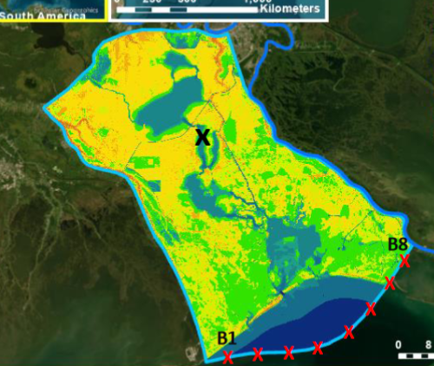
ConvLSTM
Current Datashape:
(n_samples x timesteps x n_features) Current data has a shape (10538, 7, 28) 10538 refers to the number of data points and 28 refers to the columns (multi-variables).
Features:
(WS,BL,etc)
Timesteps:
(7 Days =>
1 prediction)
Features:
(WS,BL,etc)
Samples:
(each row)

